Slide 1

The INNOVATION Project
By Tanvi, Prad, Nihira, and Harshita

Slide 2

UNDERWATER CITIES
Dwarka –
Off the coast of Gujarat, India, near modern-day Dwarka
Linked to the ancient city described in Hindu epics (Mahabharata)
Believed to be the legendary city founded by Lord Krishna
Underwater Discoveries
Marine explorations by the National Institute of Oceanography (NIO)
Submerged structures: stone walls, pillars, and grids
Dating and interpretation remain debated (claims range from 3,000 to 9,000 years old)
Archaeological Significance
Offers insight into ancient coastal urban planning
Raises questions about early maritime trade and civilization
Would you like a second slide that goes deeper into the scientific methods used in exploring Dwarka or the debates between mainstream and alternative archaeologists?

Slide 3
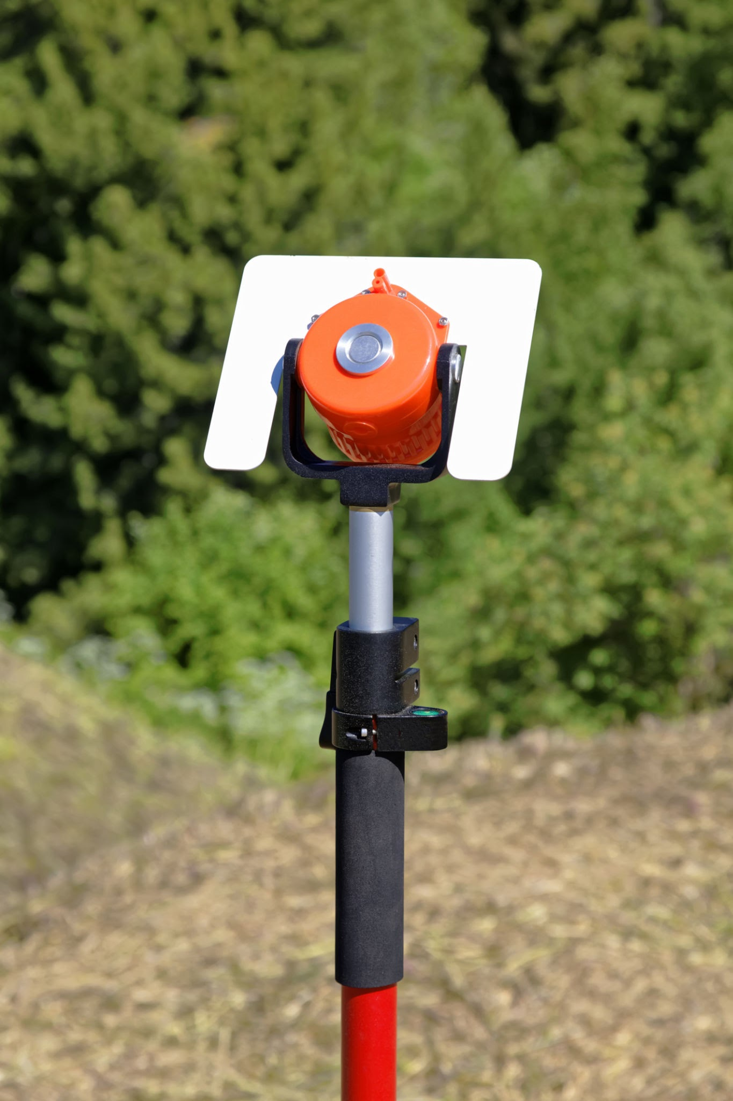
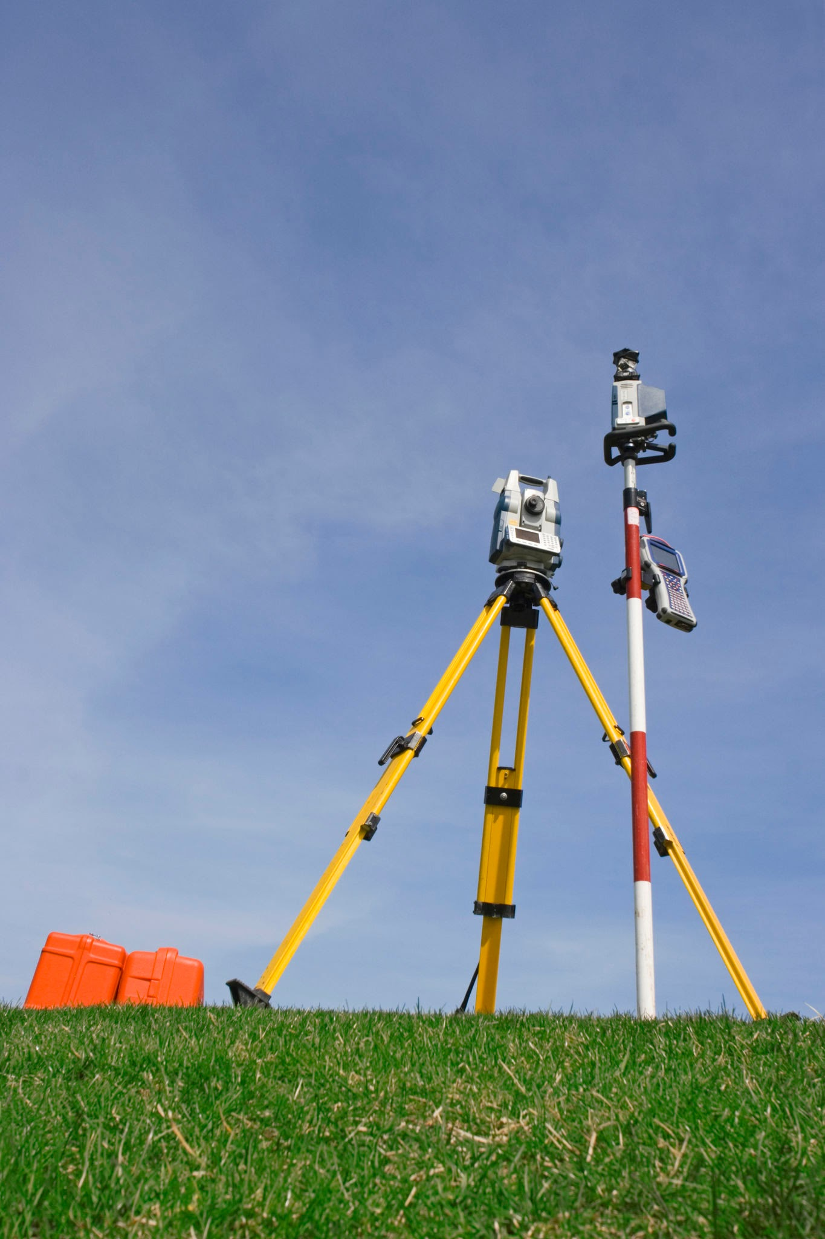
UNDERWATER CITIES
Examples of underwater cities are Pavlopetri, Greece, Derwent, UK, Baiae, Port Royal, and Shi Cheng.
In Pavlopetri archaeologists used a Robotic Total Station: A land based instrument used to find the exact location of divers holding a prism- equipped pole over the site.
AUV (Autonomous Underwater Vehicle): A quicker technique and also made to collect pictures.

Slide 4
UNDERWATER Archaeology challenges
Harsh and Inaccessible Environments
Strong currents, low visibility, deep water pressures
Require specialized diving gear or submersibles
Weather and tides limit working windows
High Costs and Limited Funding
Expensive equipment (ROVs, sonar, dive gear)
Long-term projects often underfunded
Reliance on grants or academic/government backing
Time Constraints
Limited dive times due to safety
Conservation concerns: rapid site degradation once exposed

